Slide 1
Algorithm for feature points estimation
Sathish Kasilingam

Slide 2
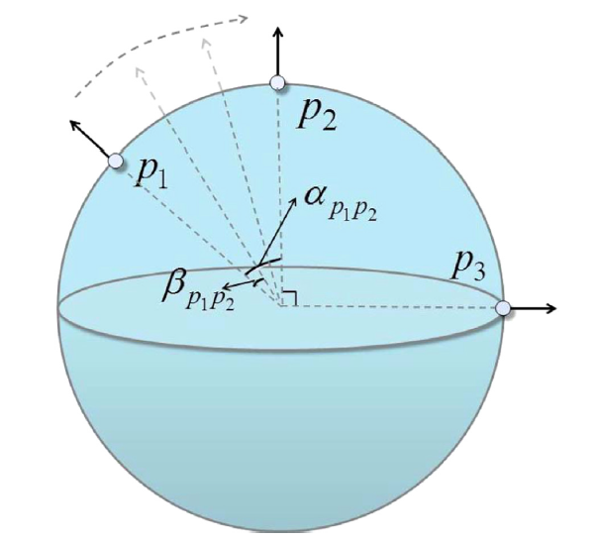

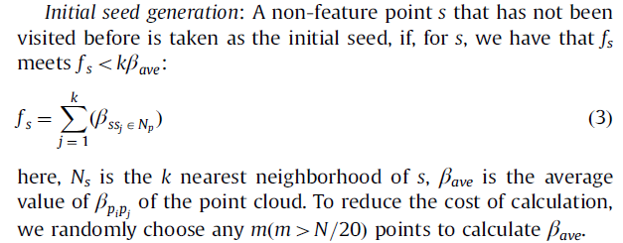

Flowchart:
Determine k nearest neighbors to determine the neighborhood of point p
The normal at p is estimated by least squares regression
The normal change within unit distance is determined
The iterations terminate when there are no more seed points
The region information of potential feature points $s_{j}$ is represented and stored by a vector $r_{sj}$

Slide 3
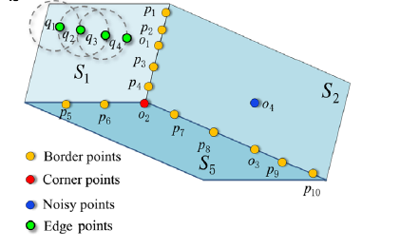
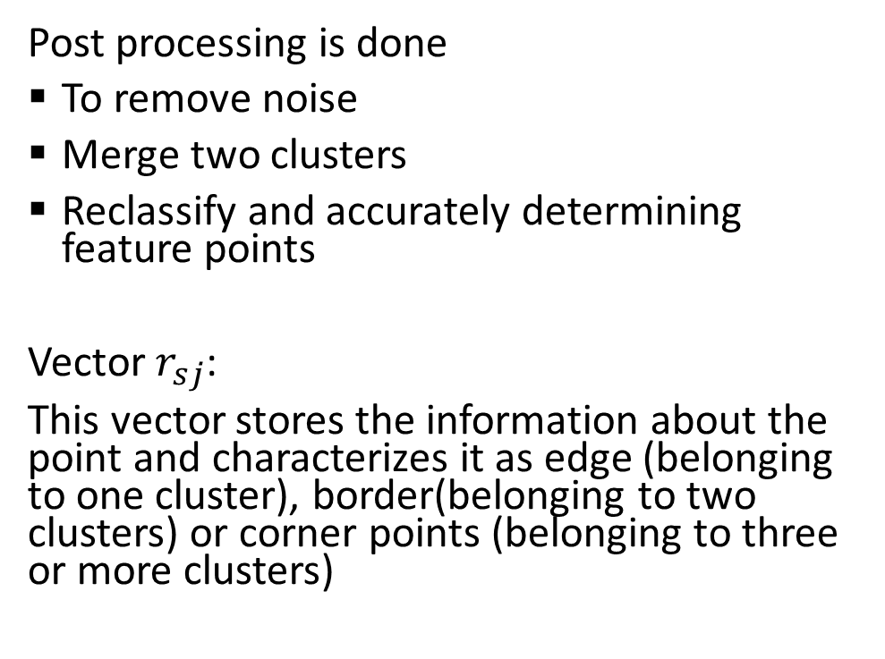
Region Information Analysis
Post processing is done
To remove noise
Merge two clusters
Reclassify and accurately determining feature points
Vector $r_{sj}$:
This vector stores the information about the point and characterizes it as edge (belonging to one cluster), border(belonging to two clusters) or corner points (belonging to three or more clusters)

Slide 4
Reference:
Zhang, Y., Geng, G., Wei, X., Zhang, S., & Li, S. (2016). A statistical approach for extraction of feature lines from point clouds. Computers & Graphics, 56, 31-45.

